Slide 1

HCI – Blackboard (LEARN@PolyU)
Lee Yin Lam Elaine*, Chong Zhi Yi, Cheung Kei Yau, Lau Ming Yin, Au Tsz Kin

Slide 2

Blackboard
provide an intuitive way to interact with different types of features for both instructors and students
Instructors:
Preview course items, assignments and tests
create and upload course content
participate in discussions
send announcements
grade assignments and upload assessments settings
change item settings for assessments and other content
Students:
View course items and course announcements
take assignments and tests
participate in discussion

Slide 3
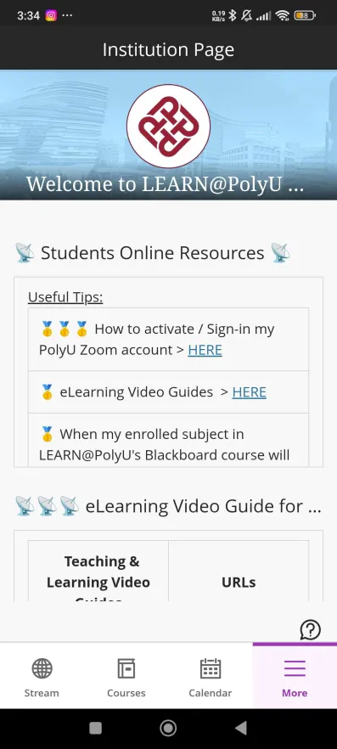
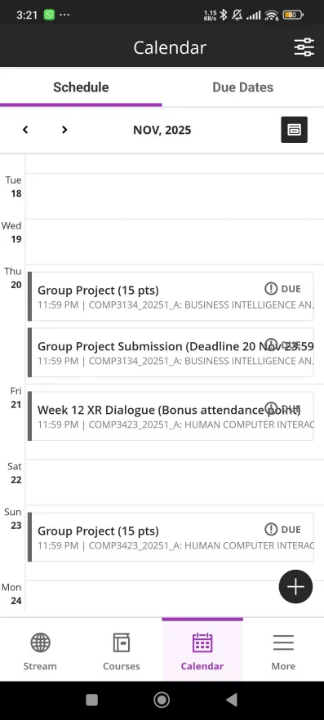
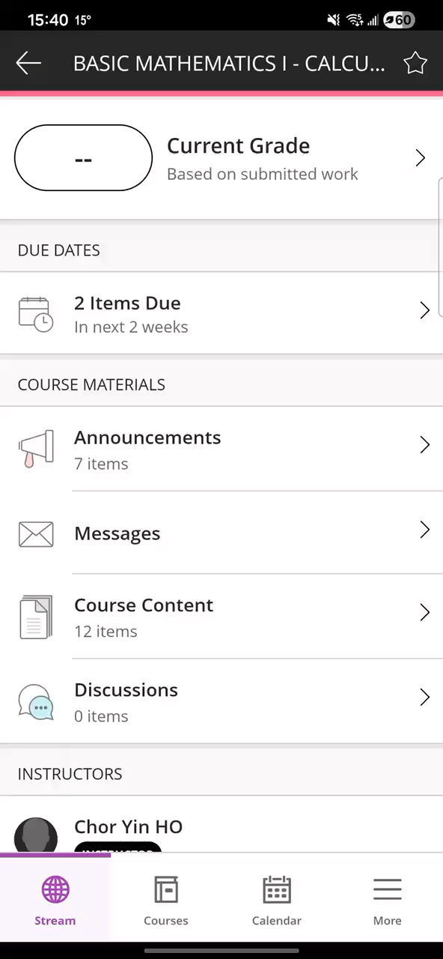
Improvement
Display problem
Excessive titles & text animation goes back and froth
Poor readability
No clues
*Video

Slide 4
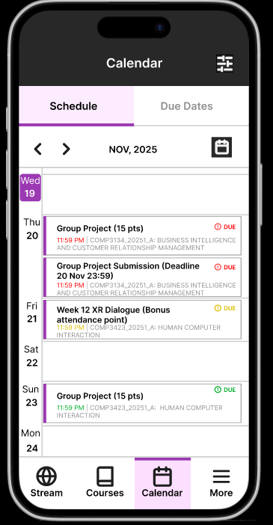
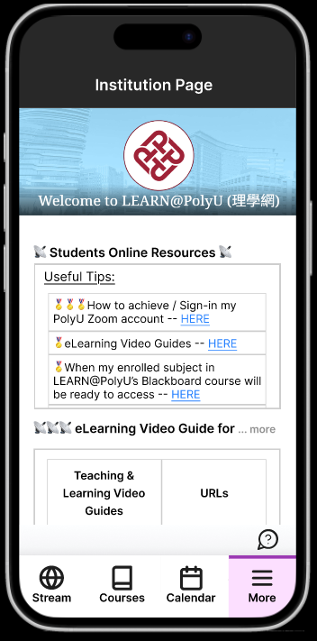
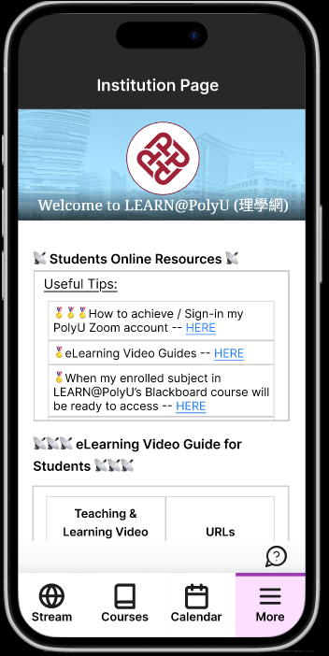
Improvement
Resize text box for long titles
Options for expanding the titles by taping
Added “…more” for clues
Due dates colouring and current date label
Tap

Slide 5
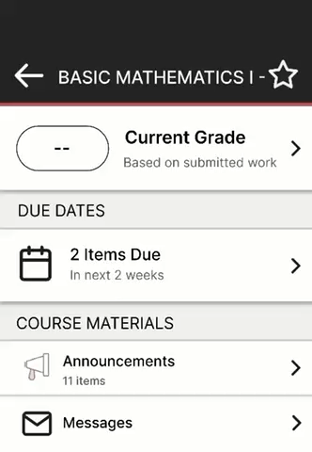
Improvement
*Video
Redesigned the scrolling text animation to loop in one direction (left to right)

Slide 6
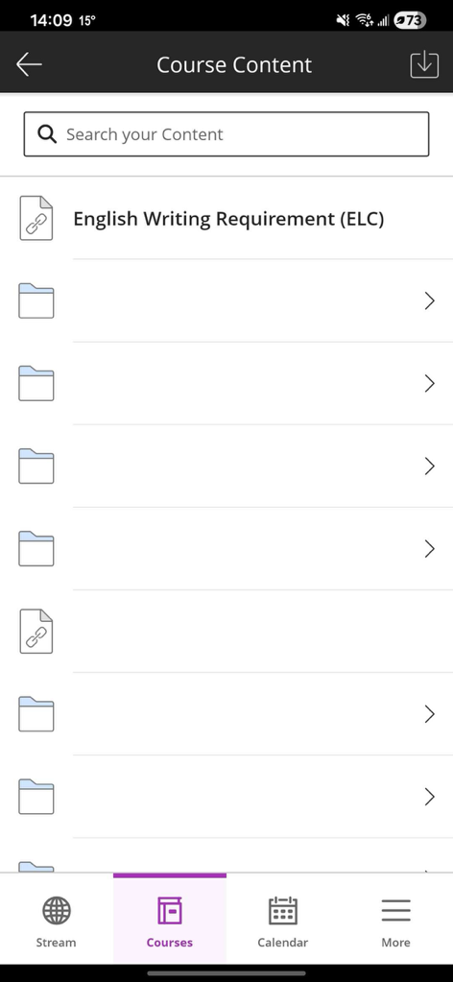
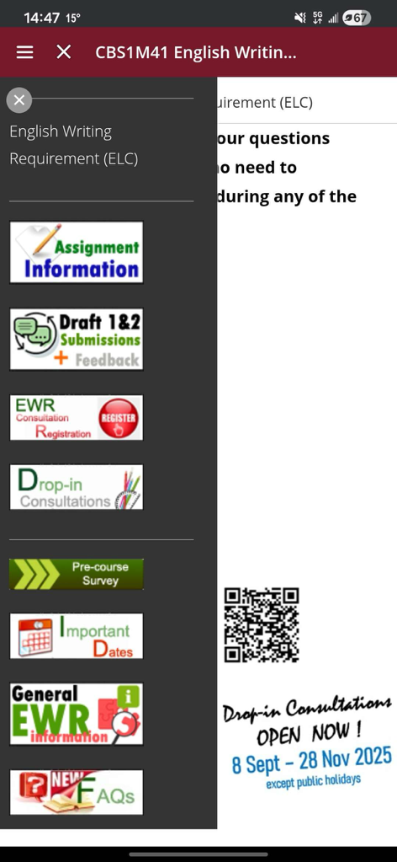
Improvement
Picture format not supported to display as folder names
Confusions for folder names

Slide 7
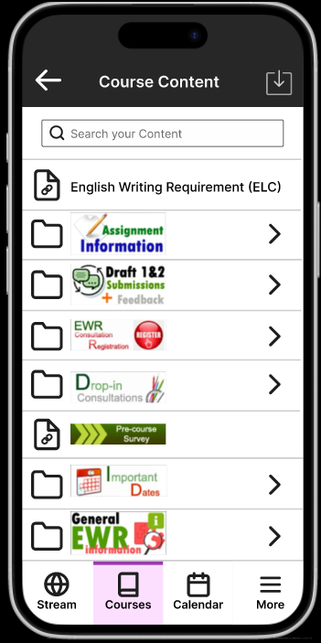
Improvement
Pictures are accepted to display as folder name, similar to what the web version does

Slide 8
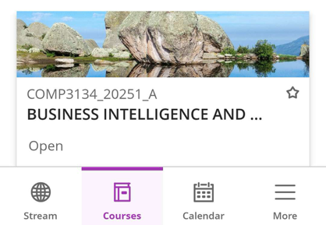
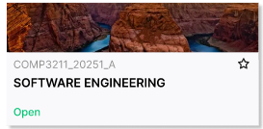
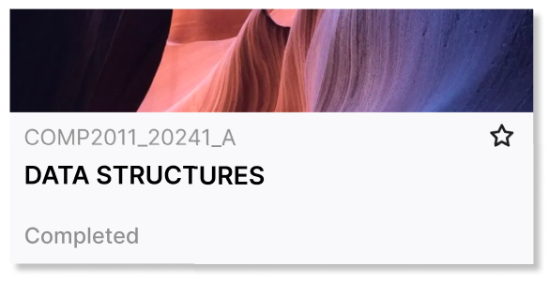
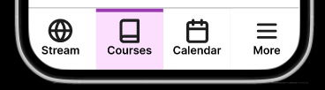
Improvement
Before:
Contrast not big enough to distinguish course state and active page
After:
Enhanced colour to highlight active page
Label colour changed for better visibility.
completed course (grey)
open course (green)

Slide 9
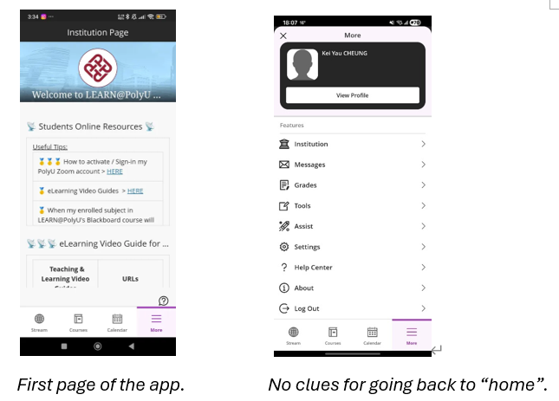

Improvement
Small cross and icons
Alignment issue
Icons looks generic

Slide 10
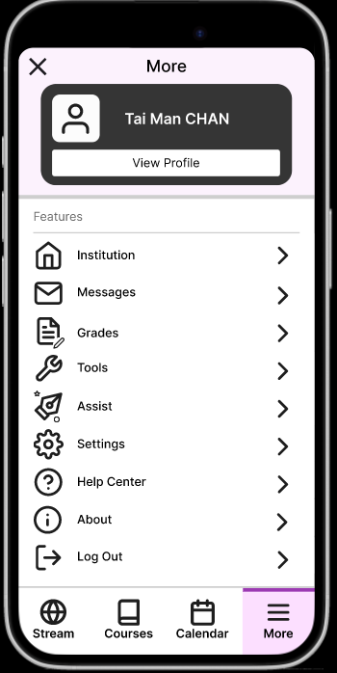
Improvement
Enlarged cross and other icons to improve accuracy and visibility
Bolded and aligned user’s name middle or better readability and provide a clear entry point to personal settings
Changed icons:
Institution → “Home”
Tools → “Spanner”
Assist → “Pen tool”

Slide 11
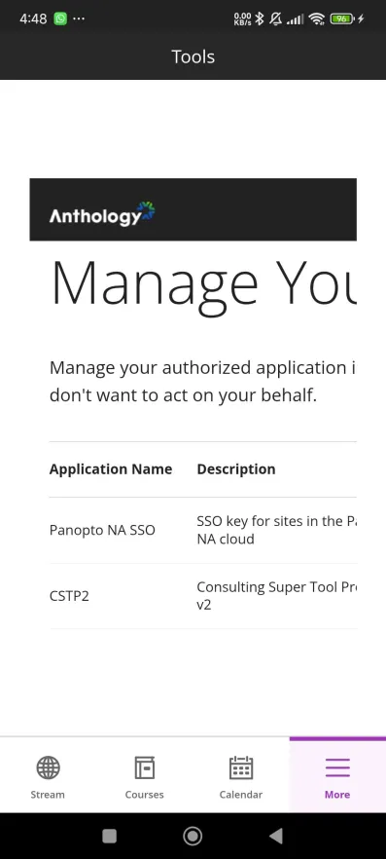
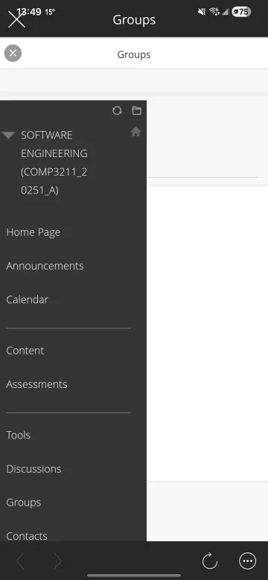
Improvement
No app version pages for Tools and Groups
Navigate to web browser when tap

Slide 12
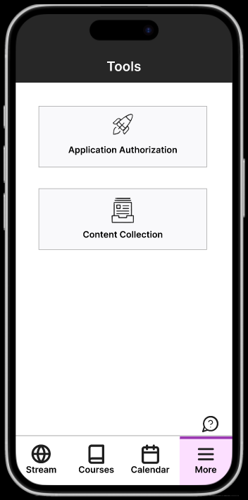
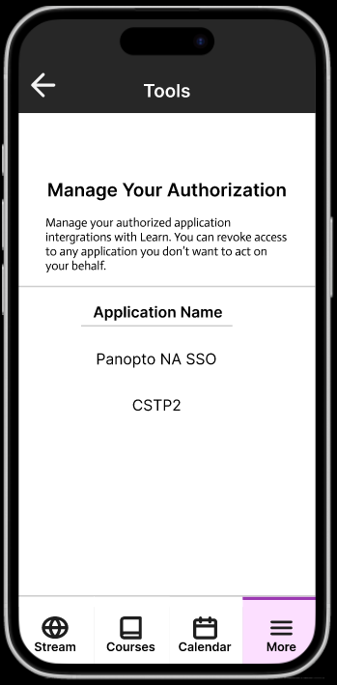
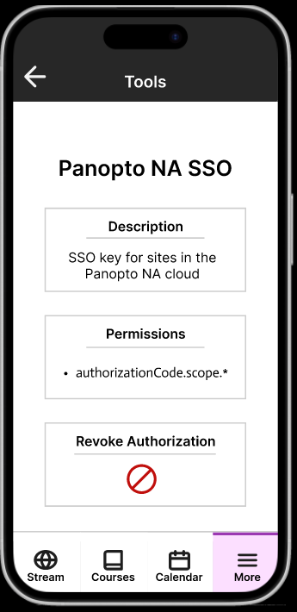
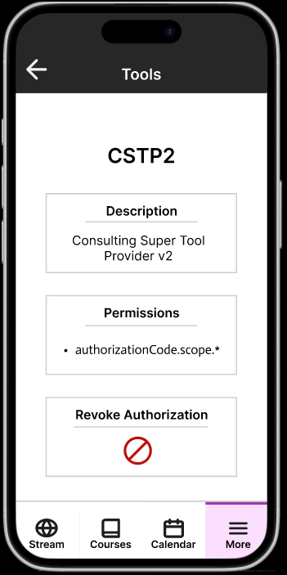
Improvement
Add pages for Tools for the app

Slide 13
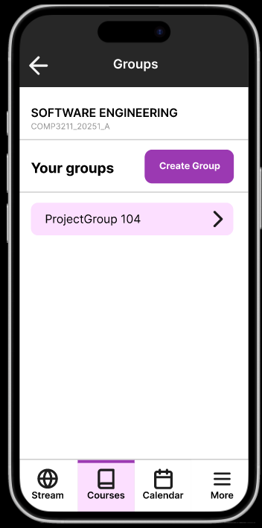
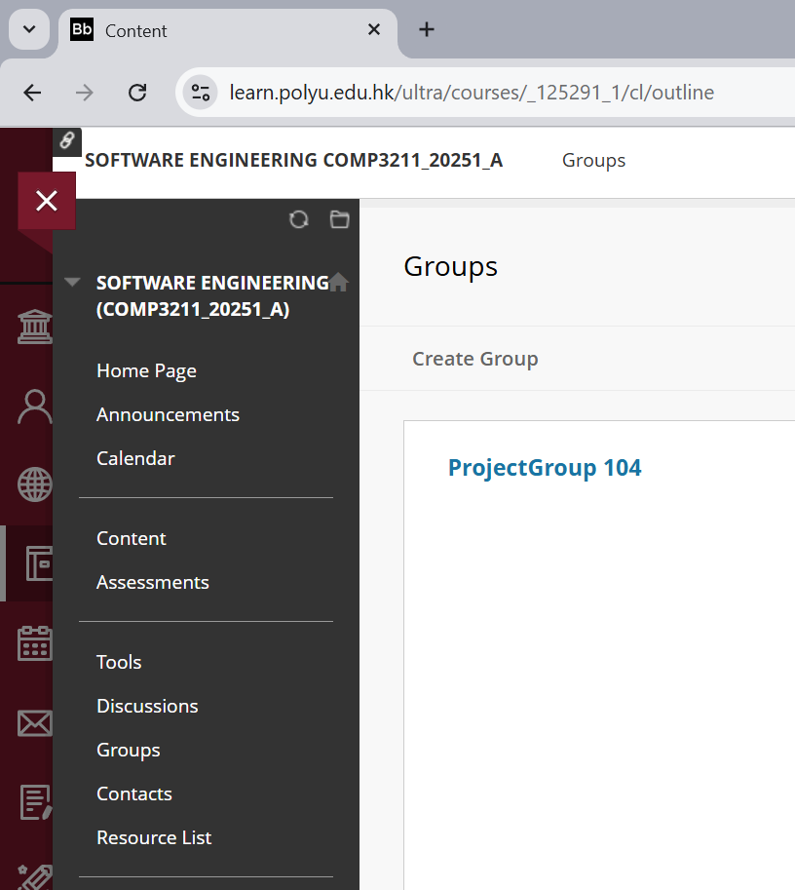
Improvement
Enhanced UI design for Groups with reference to web version design

Slide 14
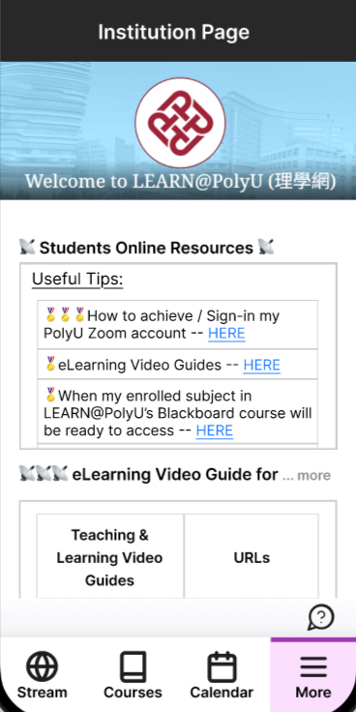
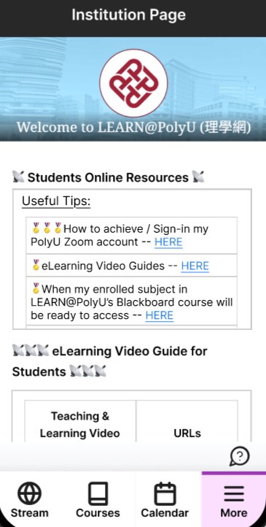
Test Path Scenario 1: View full title with excessive length
Test the functionality of displaying full title in the institution view

Slide 15
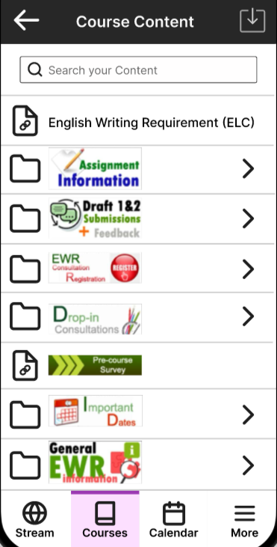
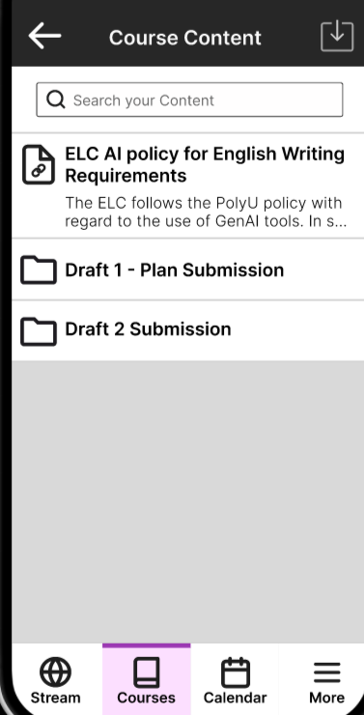
Test Path Scenario 2: Identify folder function with visuals cues
Test the use of visual cues for folders in the course content page

Slide 16
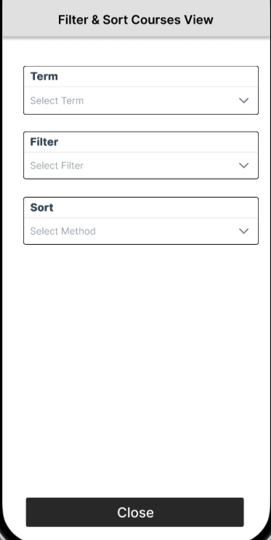
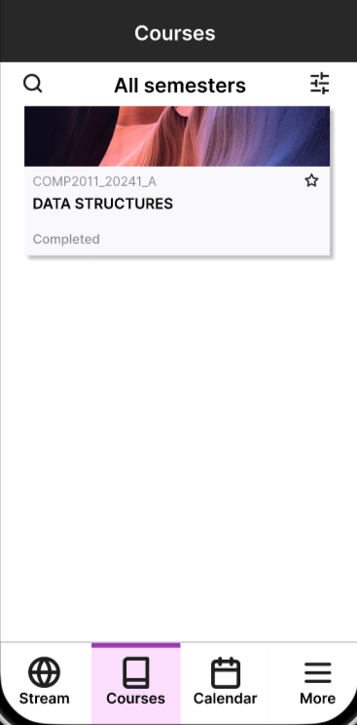
Test Path Scenario 3: Sort Courses by Filters
Test the effectiveness of the sorting feature in the course list

Slide 17
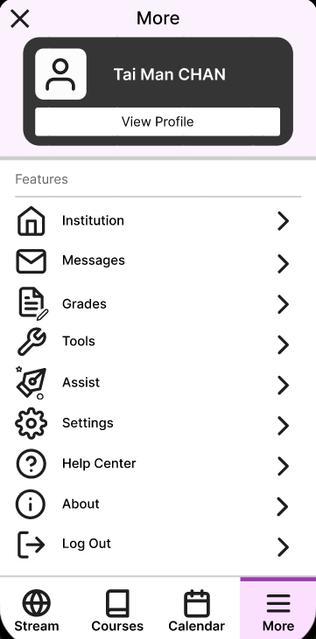
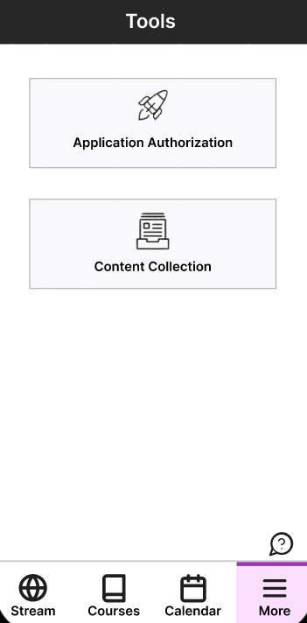
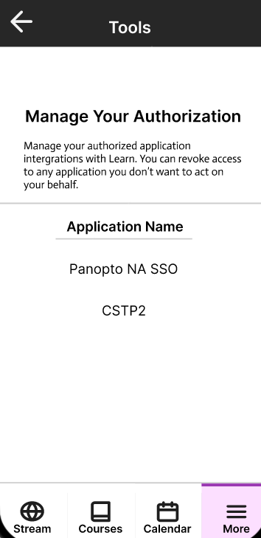
Test Path Scenario 4: Access the Tools section without redirection
Test the accessibility of the Tools section without being redirected to the web version

Slide 18
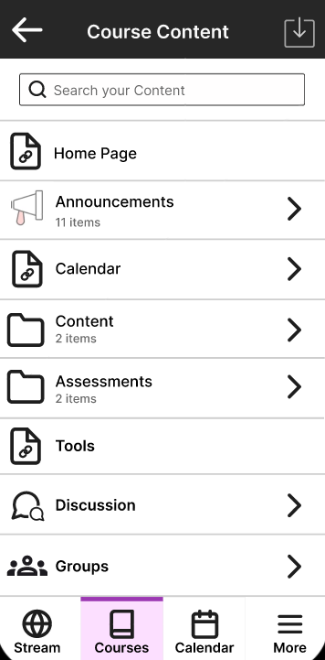
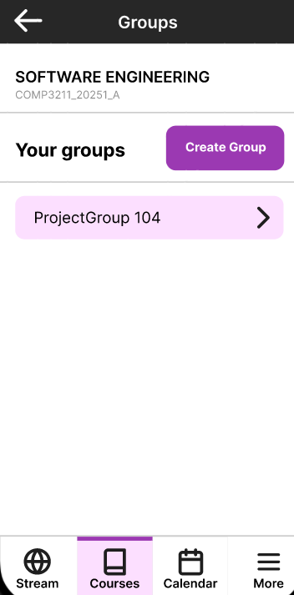
Test Path Scenario 5: Access to the Groups in Course content
Test the accessibility of the Groups section in course content

Slide 19
Results (23 responses)
Tests | Avg.Duration | SuccessRate | Drop-off | MisclickRate | Direct Success | Indirect Success
1 | 3.5s | 100% | 0% | 46.1% | 21 | 2
2 | 8.6s | 100% | 0% | 56.2% | 16 | 7
3 | 18.8 | 100% | 0% | 62.3% | 8 | 15
4 | 8.4 | 100% | 0% | 46.1% | 16 | 7
5 | 5.9 | 100% | 0% | 52.8% | 20 | 3

Slide 20
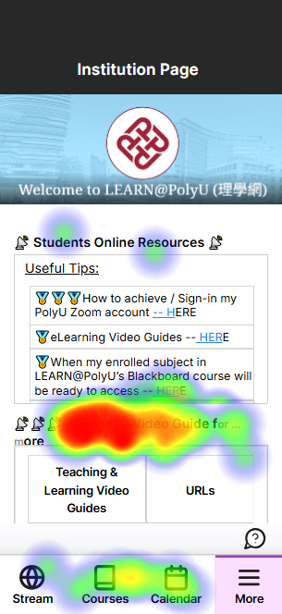
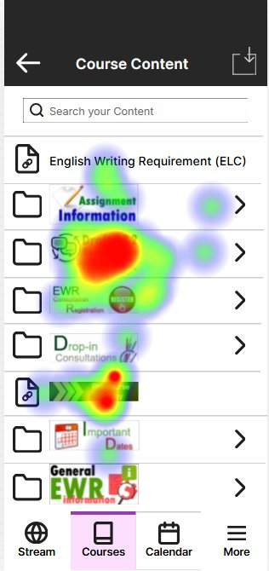
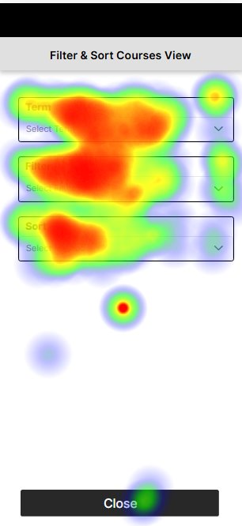
Results (Sample heatmaps)

